Slide 1
Model Predictive Control for a quadrotor in dynamic environments
Optimization of Mechatronic Systems H04U1a
Elias Rached
Mohamad Sayegh

Slide 2
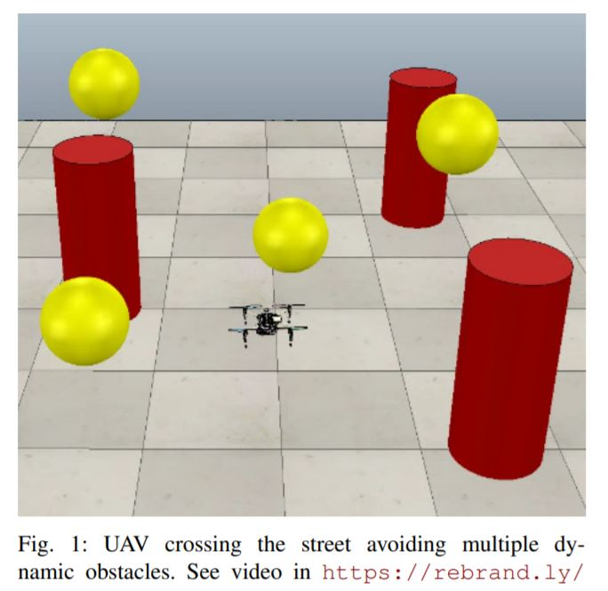
Context of the Project: Reference Paper
Based on the research paper “Model Predictive Control for Aerial Collision Avoidance in dynamic environments”
Goal is to safely navigate in a workspace populated by static and moving obstacles.
Improve the fluency of avoidance maneuvers by reformulating the obstacles as orientable ellipsoids.

Slide 3

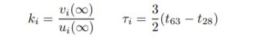
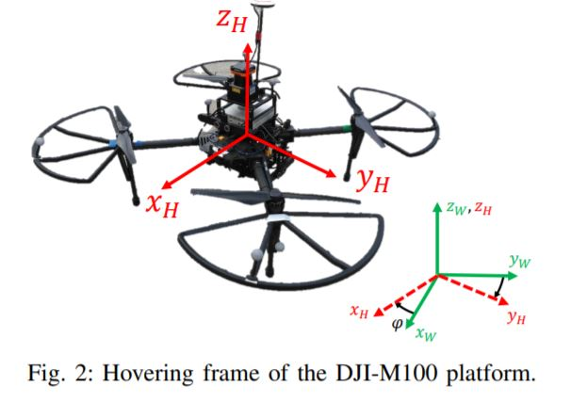
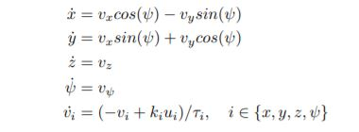
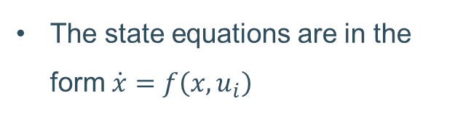
Context of the Project: The quadrotor Model
The quadrotor is modelled as a differentially flat system with the states:
Using an identification procedure the following parameters were calculated:
The state equations are in the form $\dot{x}=f\left(x, u_{i}\right)$

Slide 4
Objectives
Implement point-to-point Model Predictive Control
Obstacle Avoidance in static and dynamic environment (Moving obstacles)
Finding the best formulation of the problem ( MPC and Obstacles )
Exploring time optimality (comparison several methods / parameters)
How to escape Local minima

Slide 5
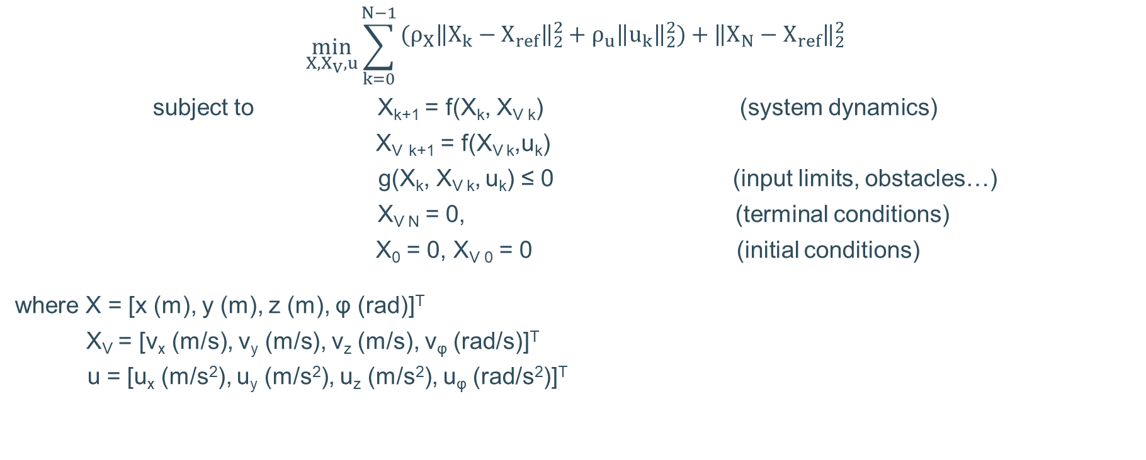
Formulation of the Model Predictive Control Problem
$$\min_{X, X_{V},u}{\sum_{k=0}^{N−1}{\begin{aligned}(ρ_{X}{\left\|X_{k}−X_{ref}\right\|}_{2}^{2}+ρ_{u}{\left\|u_{k}\right\|}_{2}^{2})+{\left\|X_{N}−X_{ref}\right\|}_{2}^{2} \\ \end{aligned}}}$$
subject to X_{k+1} = f(X_{k}, X_{V k}) (system dynamics)
X_{V} _{k+1} = f(X_{V k},u_{k})
g(X_{k}, X_{V k}, u_{k}) ≤ 0 (input limits, obstacles…)
X_{V N} = 0, (terminal conditions)
X₀ = 0, X_{V 0} = 0 (initial conditions)
where X = [x (m), y (m), z (m), φ (rad)]^{T}
X_{V} = [v_{x} (m/s), v_{y} (m/s), v_{z} (m/s), v_{φ} (rad/s)]^{T}
u = [u_{x} (m/s²), u_{y} (m/s²), u_{z} (m/s²), u_{φ} (rad/s²)]^{T}

Slide 6
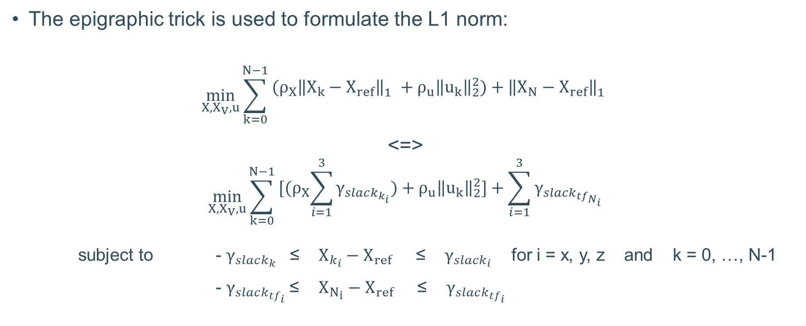
Alternative formulation using L1 norm
The epigraphic trick is used to formulate the L1 norm:
$$\min_{X, X_{V},u}{\sum_{k=0}^{N−1}{\begin{aligned}(ρ_{X}{\left\|X_{k}−X_{ref}\right\|}_{1}^{}+ρ_{u}{\left\|u_{k}\right\|}_{2}^{2})+{\left\|X_{N}−X_{ref}\right\|}_{1}^{} \\ \end{aligned}}}$$
<=>
$$\min_{X, X_{V},u}{\sum_{k=0}^{N−1}{\begin{aligned}[{(ρ}_{X}\sum_{i=1}^{3}{γ_{slack_{k_{i}}})}+ρ_{u}{\left\|u_{k}\right\|}_{2}^{2}]+\sum_{i=1}^{3}{γ_{slack_{tf_{N_{i}}}}} \\ \end{aligned}}}$$
subject to - $γ_{slack_{k}}$ ≤ $X_{k_{i}}−X_{ref}$ ≤ $γ_{slack_{i}}$ for i = x, y, z and k = 0, …, N-1
- $γ_{slack_{tf_{i}}}$≤ $X_{N_{i}}−X_{ref}$ ≤ $γ_{slack_{tf_{i}}}$

Slide 7
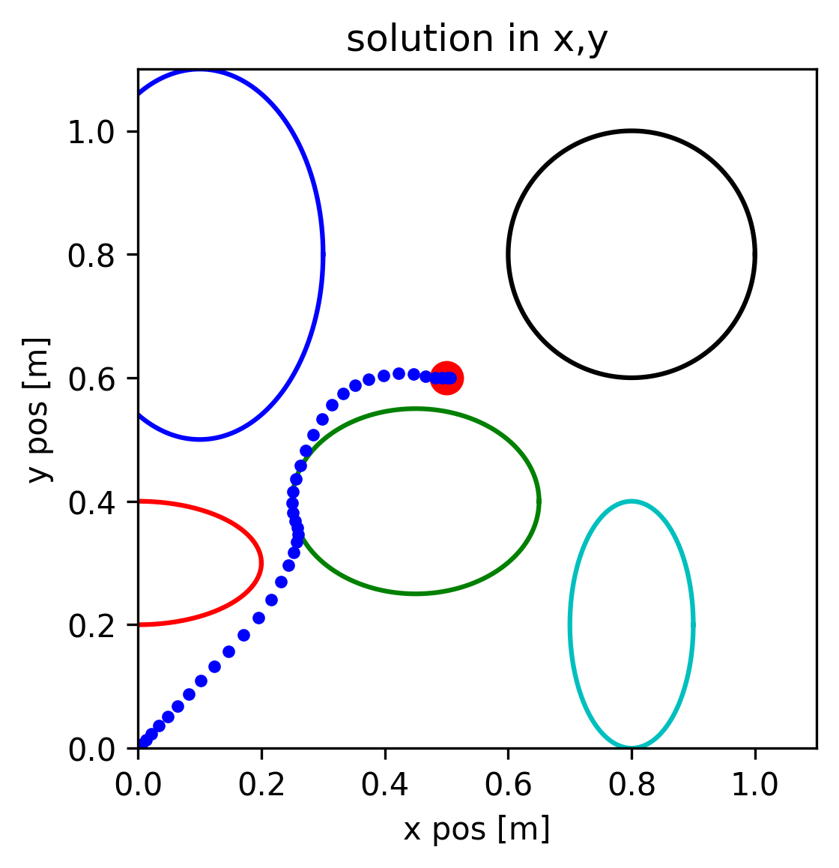
First run of MPC in static environment
First run of MPC:
L2 norm
Static environment
Hard constraints
With an available path (free of local minima)
Execution Time: 2.1 s
OCP Computation Time: 20-30 ms /iteration
Position clearance: 1 mm
Velocity clearance: 1e-5 m/s

Slide 8
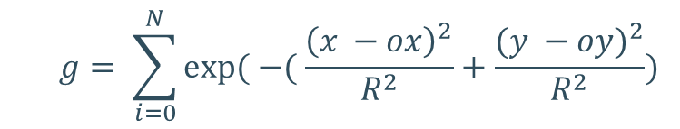
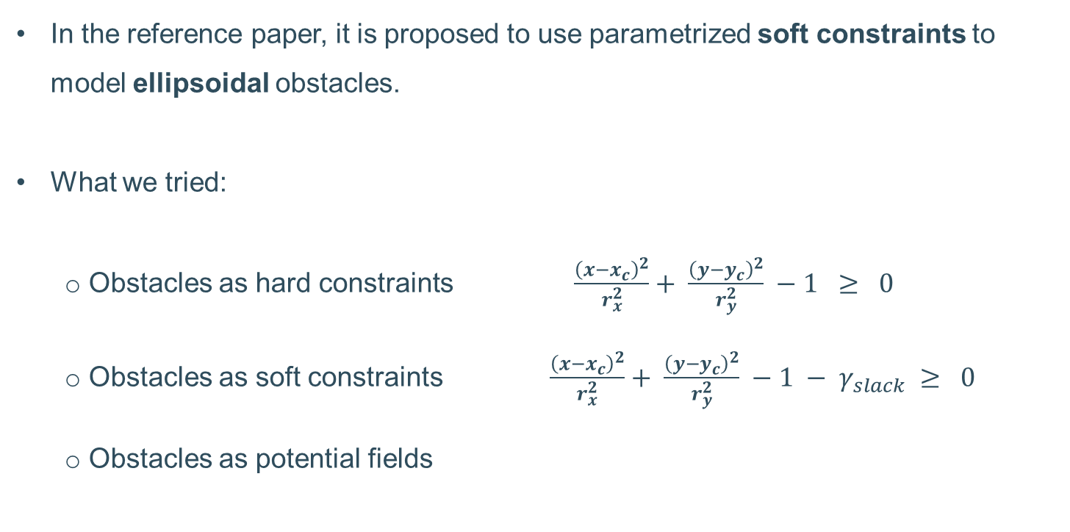
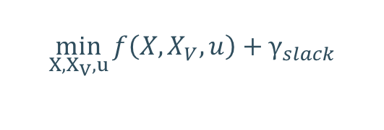
Constraints for obstacle avoidance
In the reference paper, it is proposed to use parametrized soft constraints to model ellipsoidal obstacles.
What we tried:
Obstacles as hard constraints $\frac{{\left(x−x_{c}\right)}^{2}}{r_{x}^{2}}+ \frac{{\left(y−y_{c}\right)}^{2}}{r_{y}^{2}} −1 ≥ 0$
Obstacles as soft constraints $\frac{{\left(x−x_{c}\right)}^{2}}{r_{x}^{2}}+ \frac{{\left(y−y_{c}\right)}^{2}}{r_{y}^{2}} −1 − γ_{slack} ≥ 0$
Obstacles as potential fields
$$\min_{X, X_{V},u}{f\left(X,X_{V},u\right)+γ_{slack}}$$
$$g= \sum_{i=0}^{N}{exp⁡( −( \frac{{\left(x −ox\right)}^{2}}{R^{2}}+\frac{{(y −oy)}^{2}}{R^{2}})}$$

Slide 9
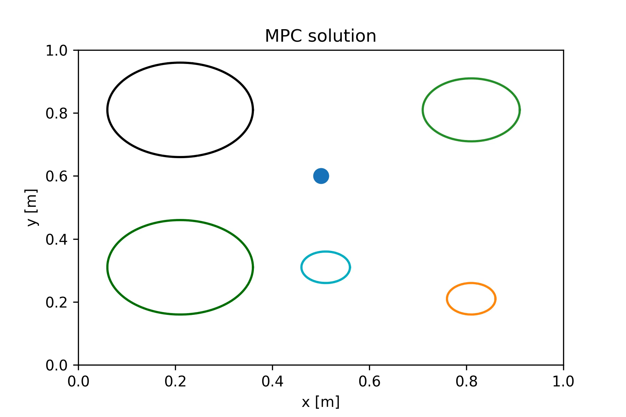
Static and Dynamic Environment Description
Cylinders only (easier to imagine in 2D cross section)
In dynamic environment: cylinders in bouncing random movement

Slide 10
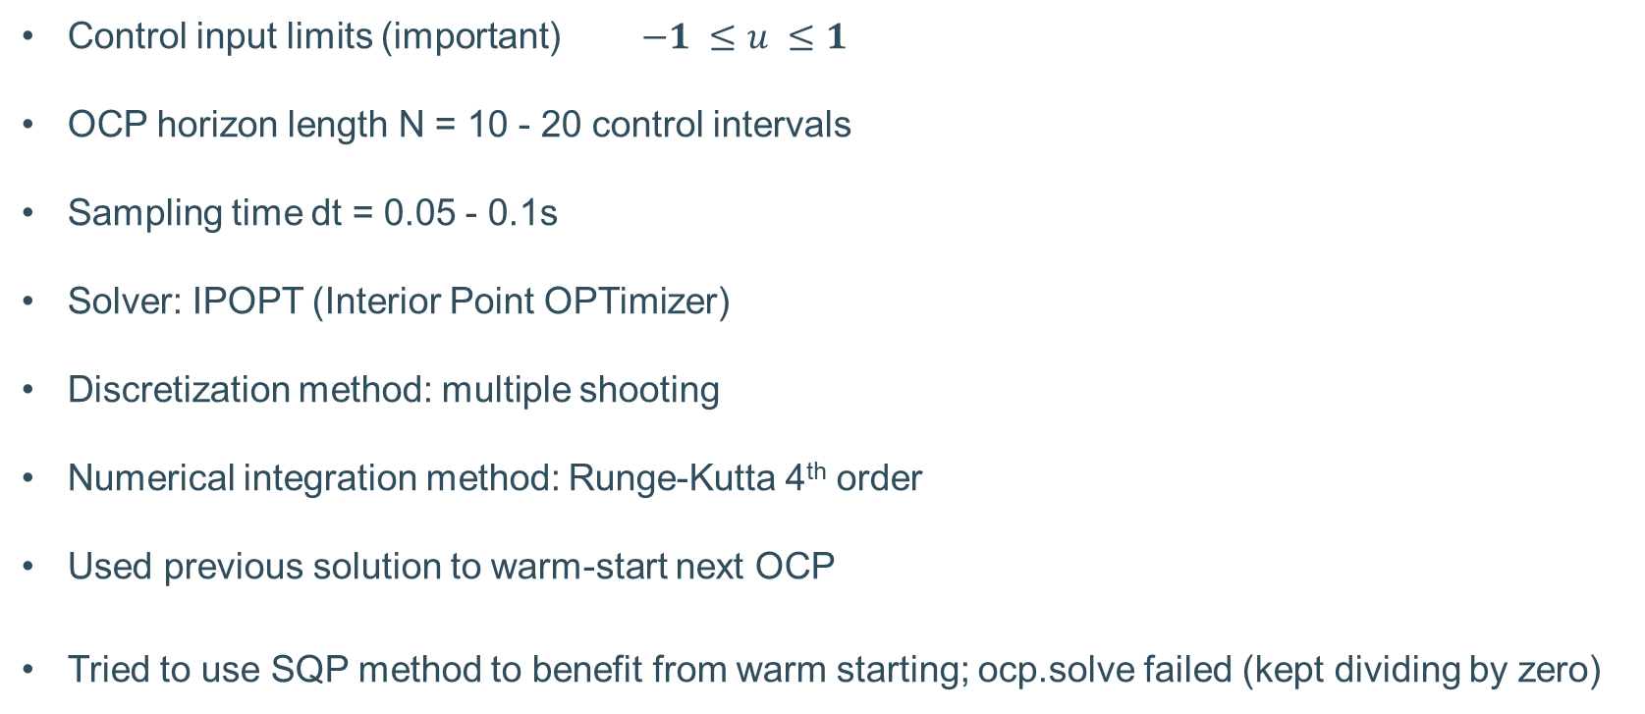
Application
Control input limits (important) $−1 ≤u ≤1$
OCP horizon length N = 10 - 20 control intervals
Sampling time dt = 0.05 - 0.1s
Solver: IPOPT (Interior Point OPTimizer)
Discretization method: multiple shooting
Numerical integration method: Runge-Kutta 4th order
Used previous solution to warm-start next OCP
Tried to use SQP method to benefit from warm starting; ocp.solve failed (kept dividing by zero)

Slide 11
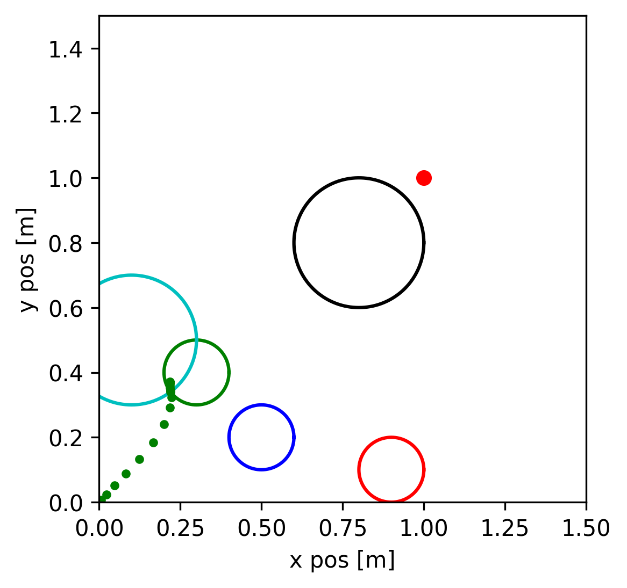
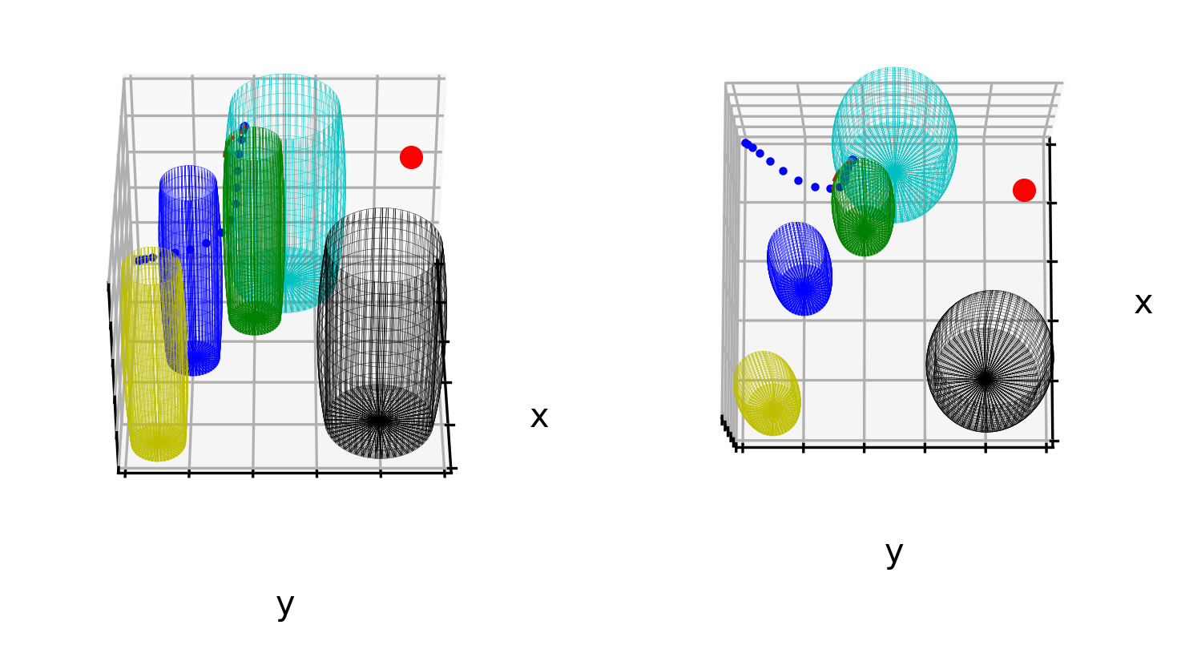
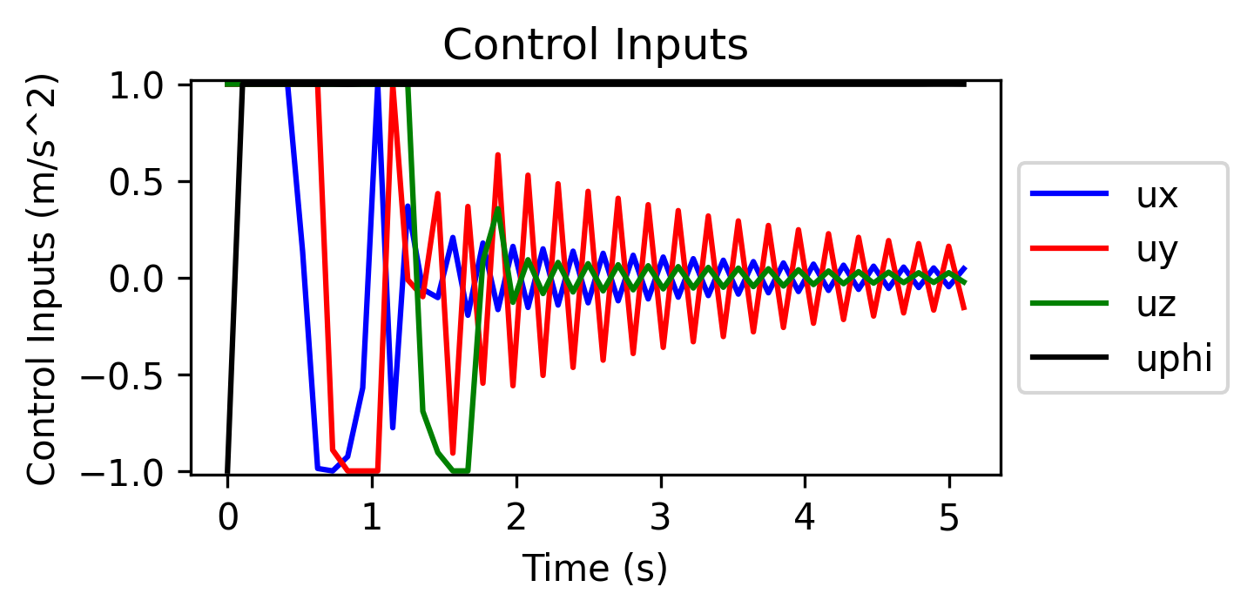
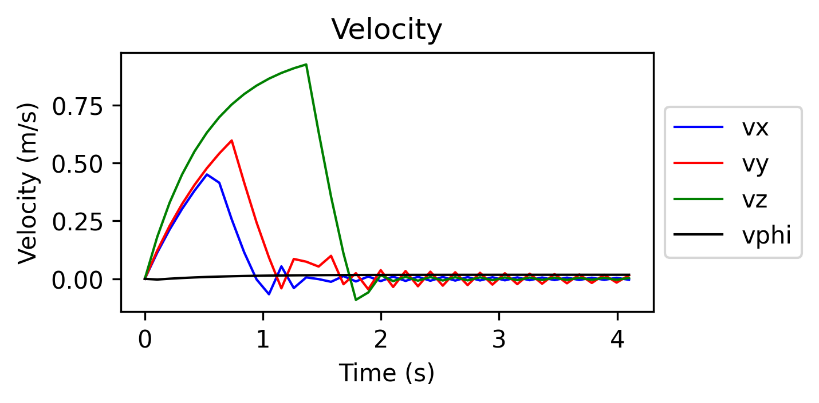
Using ellipsoids to model constraints
z
Cylinders are modelled as ellipsoids
Both soft and hard constraints were applied
Local minimum appears if the goal is behind obstacles
Local minimum = expected problem in NLP
x
x
y
z
x
y

Slide 12
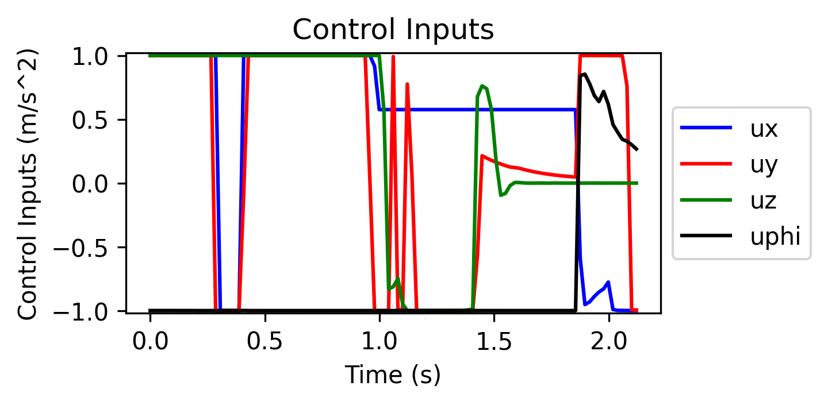
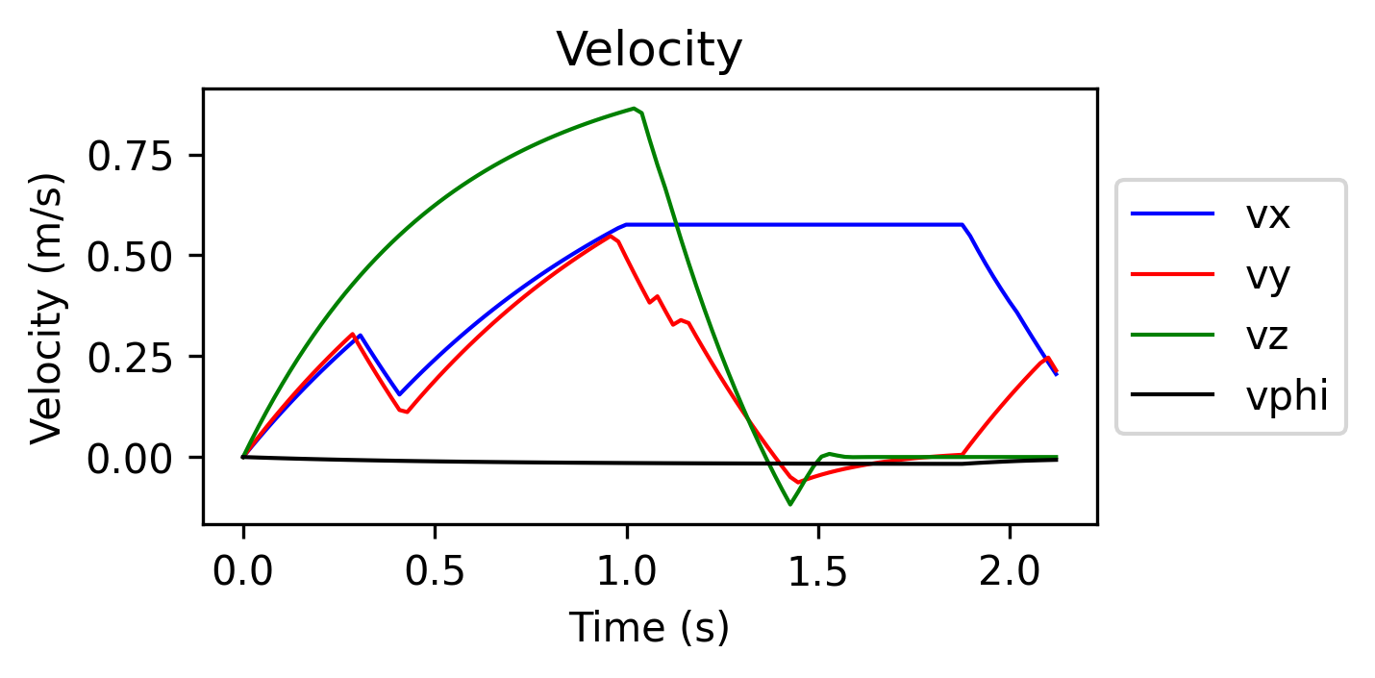
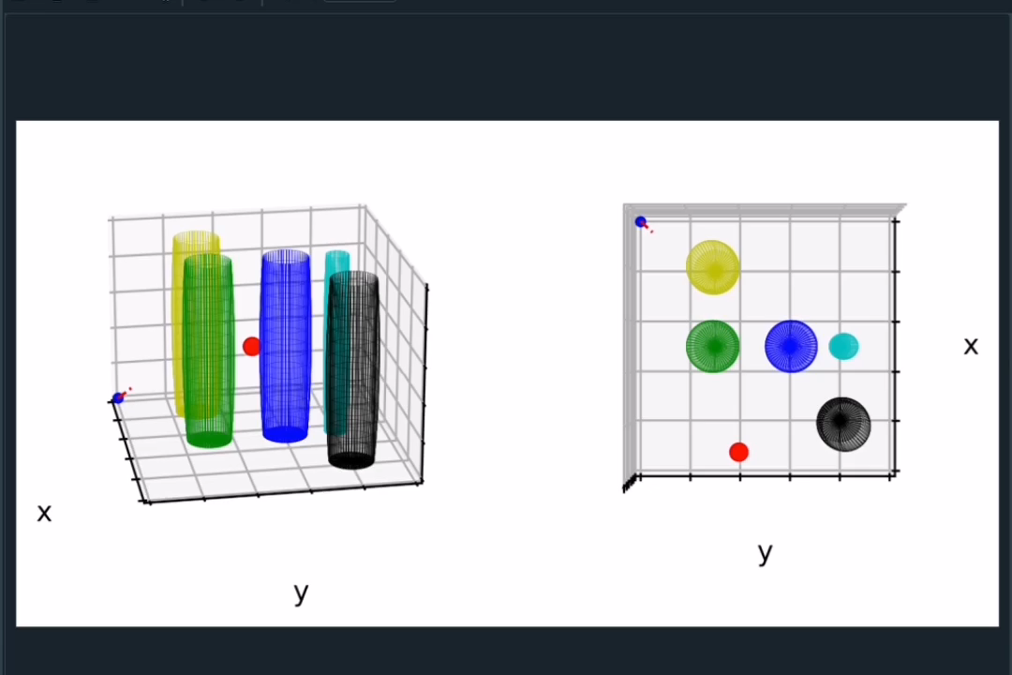
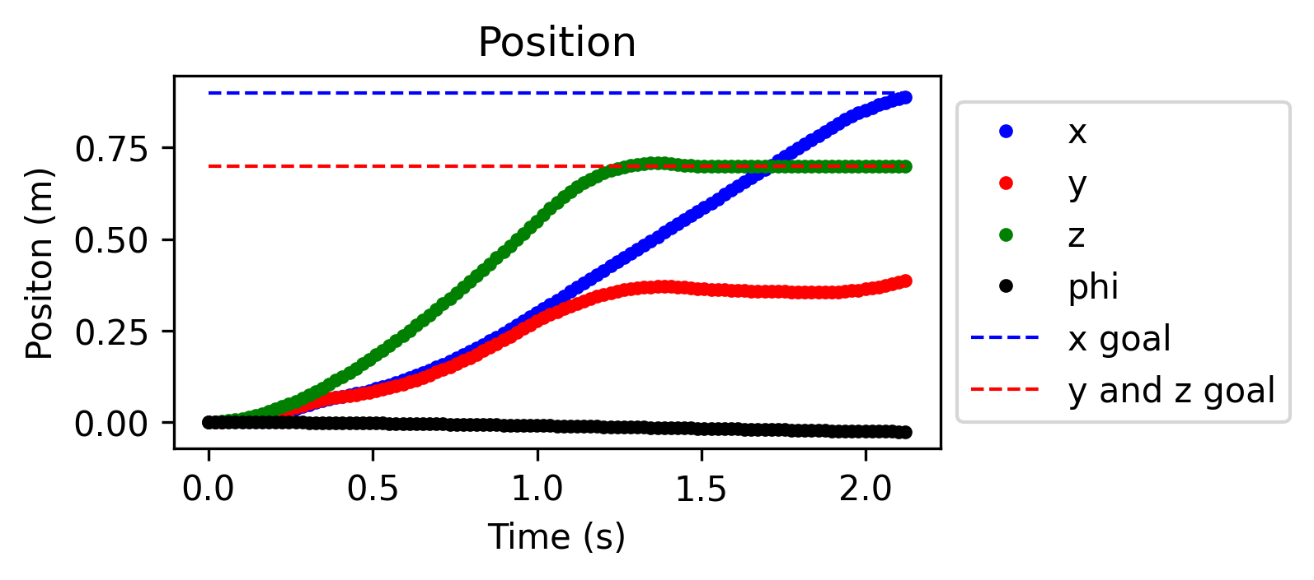
Using ellipsoids to model constraints
Moving obstacles = no local minimum encountered
Low dt (below 0.05 s) needed to avoid collisions

Slide 13
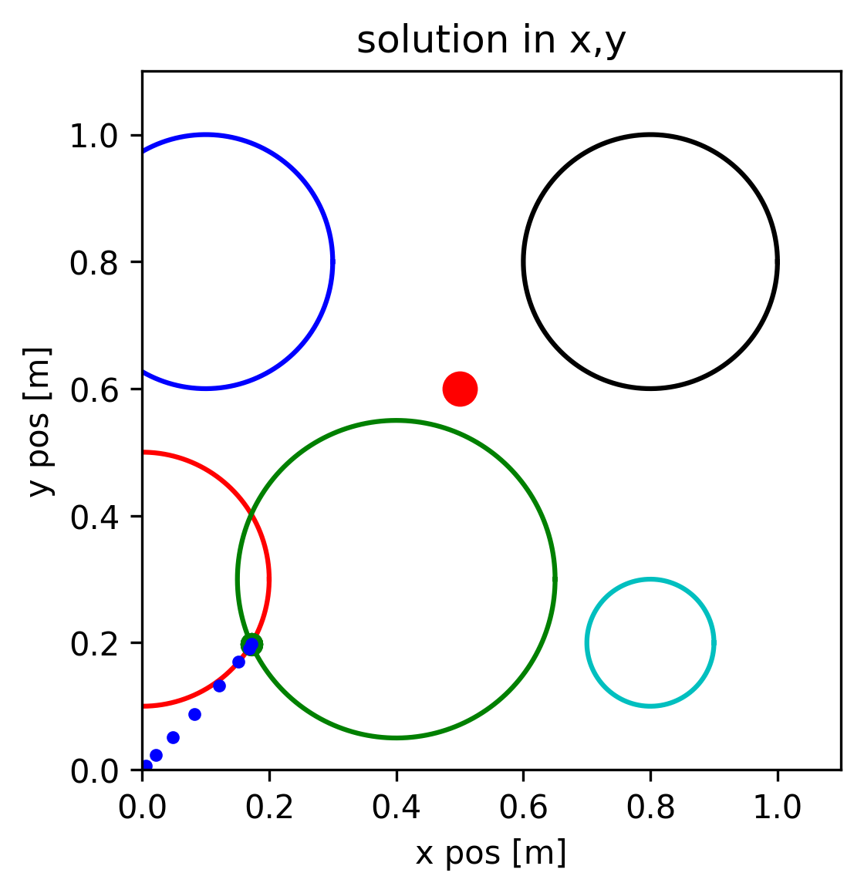
Dealing with Local Minima
Methods of escaping the local minimum are proposed:
Obstacle merging: when obstacles are close enough they are merged into one obstacle
A* trajectory guiding: when confirmed to be stuck in a local minimum, an A* trajectory is found, and intermediate points are extracted to guide the drone away
Potential Field method could help escape certain local minima (if close to obstacles)

Slide 14
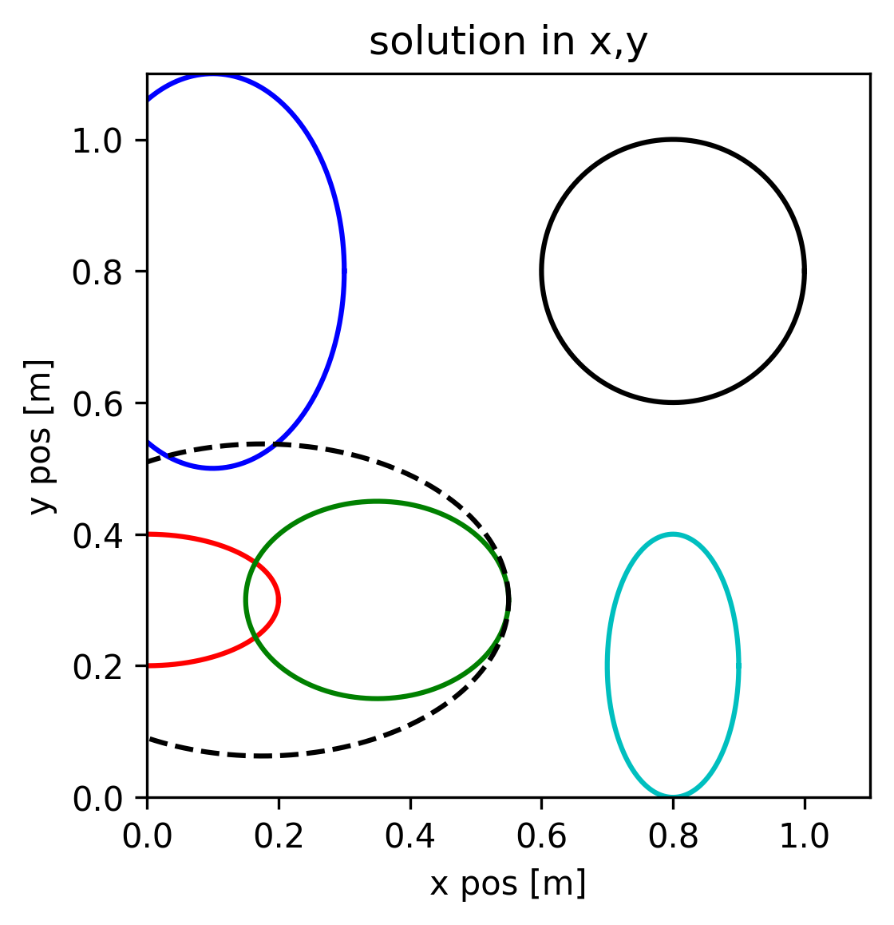
Local min problem: Obstacles Merging
When elliptic obstacles are intersecting along x or y, they are merged along that direction, such that the original centers become the foci of the new ellipse.
Feasible space is lost
In real time: Needs to be done before every MPC iteration
More difficult to merge in different dimensions/directions
Both L1 and L2 compared

Slide 15
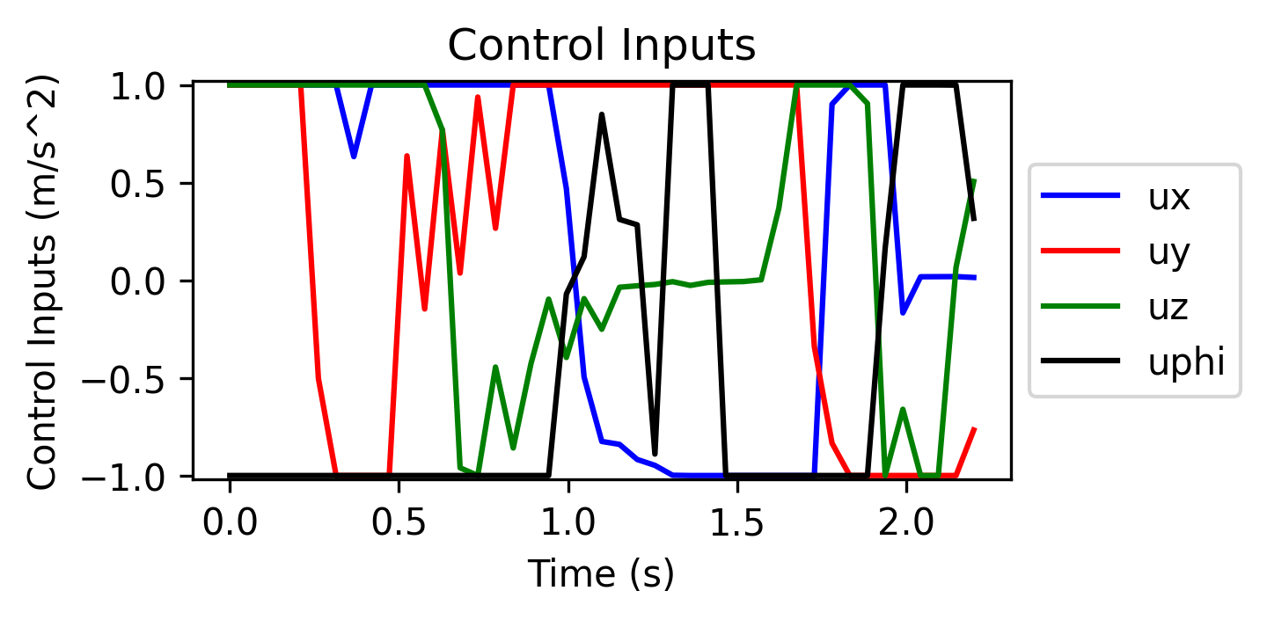
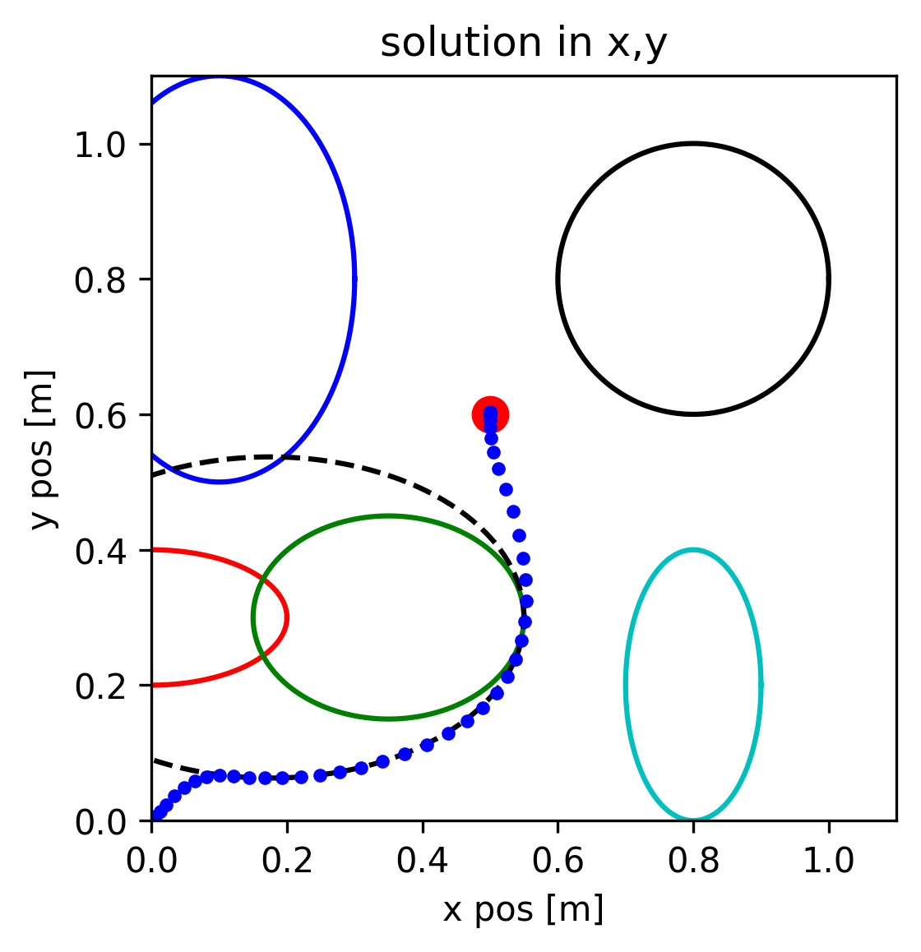
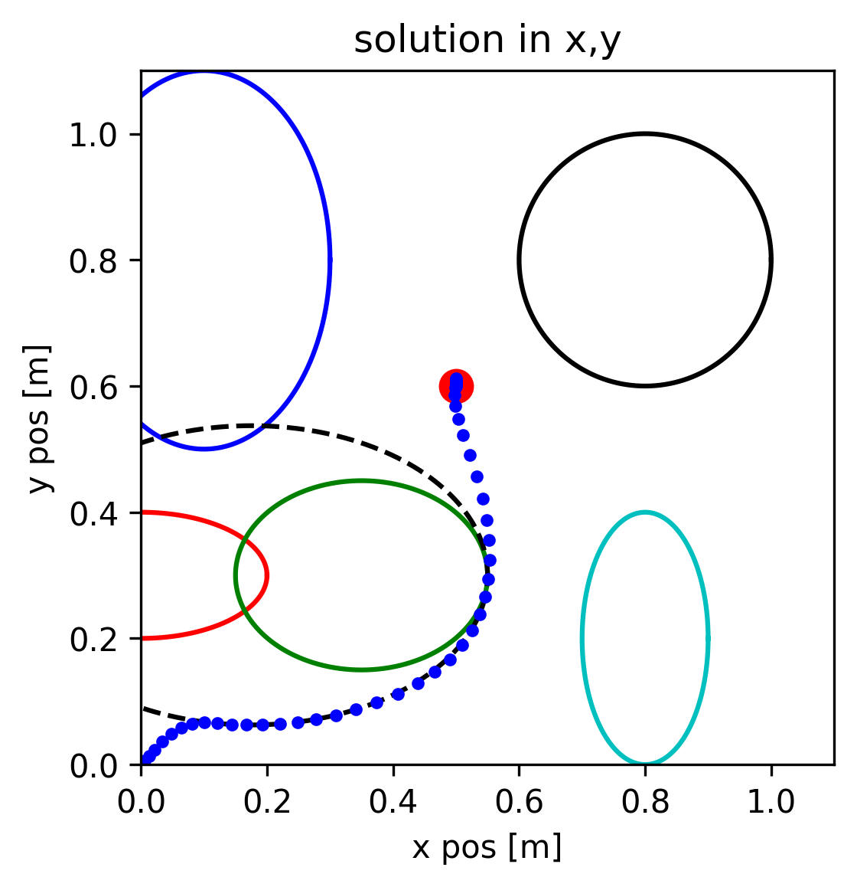
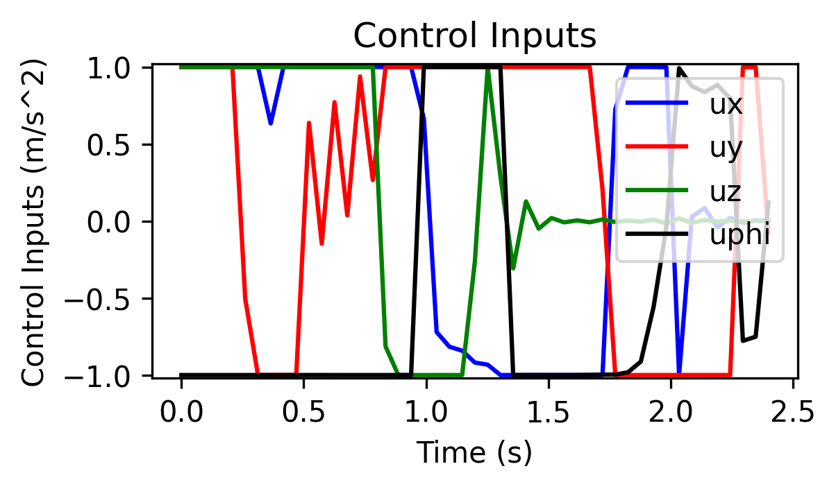
L1 vs L2 for time optimality and obstacle avoidance
Execution Time: 2.2s
Computation Time: ~20ms/iteration
Position clearance: 1mm
Velocity clearance: 1e-5 m/s
Execution Time: 2.4s
Computation Time: ~20ms/iteration
Position clearance: 1mm
Velocity clearance: 1e-5 m/s

Slide 16
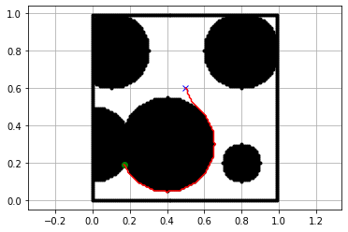
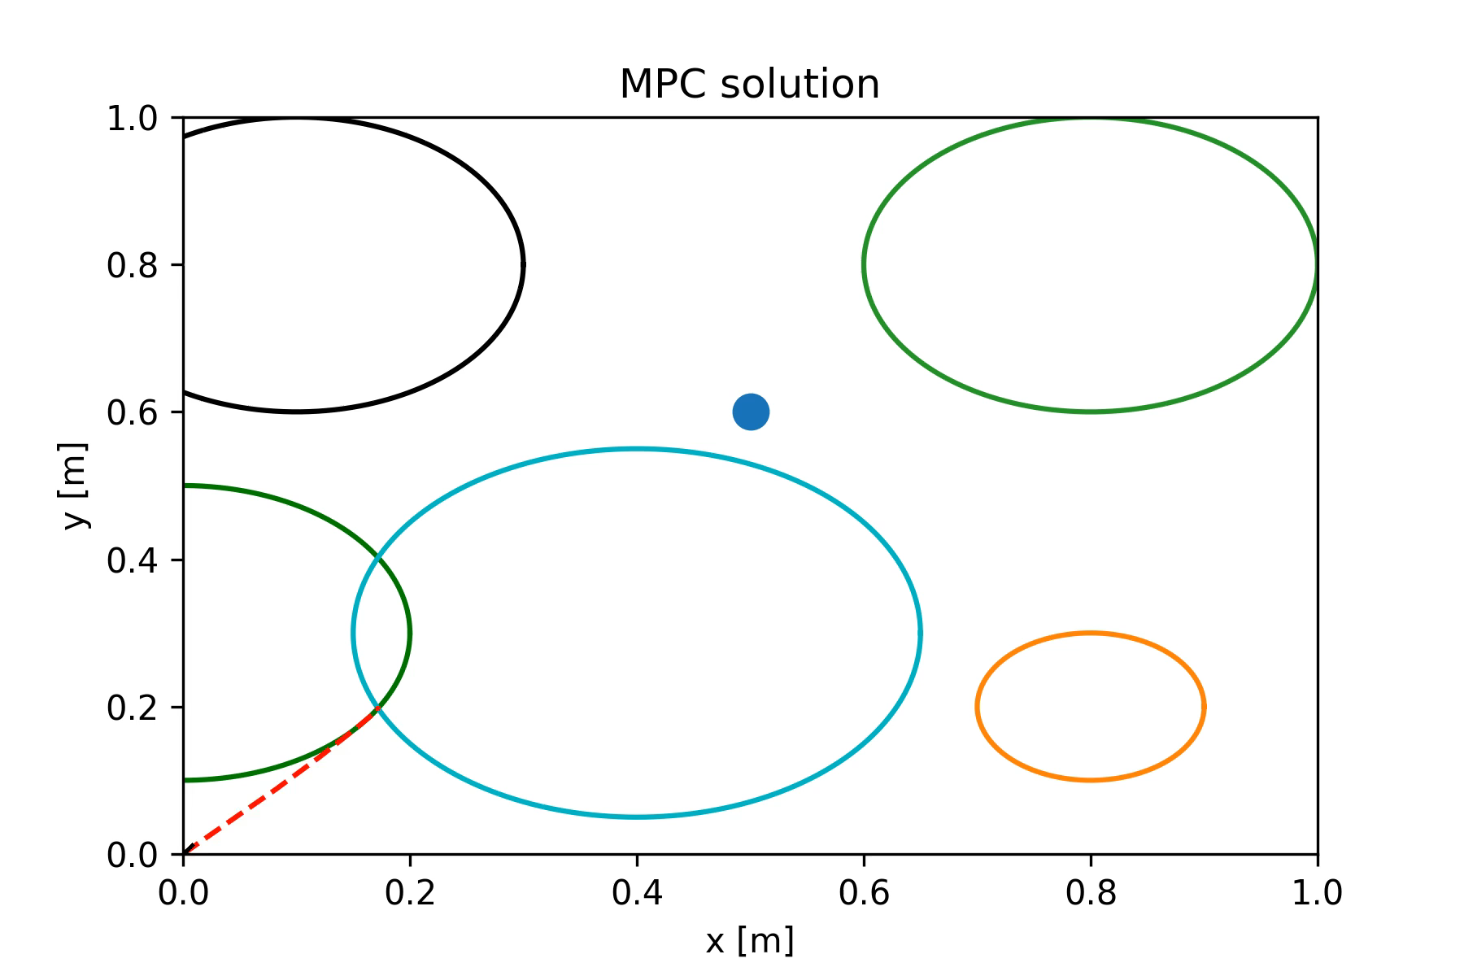
Local min problem: intermediate states
A* Solution
Source: “A Penalty Method Based Approach for Autonomous Navigation using Nonlinear Model Predictive Control”
Local minimum is detected using objective function evaluation
A* search to find a path to the goal
Intermediate points selected where trajectory direction changes
Temporarily set intermediate points as terminal constraint
Effect of time optimality: has to first fall in local minima, has to asymptotically approach every intermediate state as an end point, contradictory method.
Hermans, Ben, et al. “A Penalty Method Based Approach for Autonomous Navigation Using Nonlinear Model Predictive Control.” IFAC-PapersOnLine, vol. 51, no. 20, 2018, pp. 234–240.

Slide 17
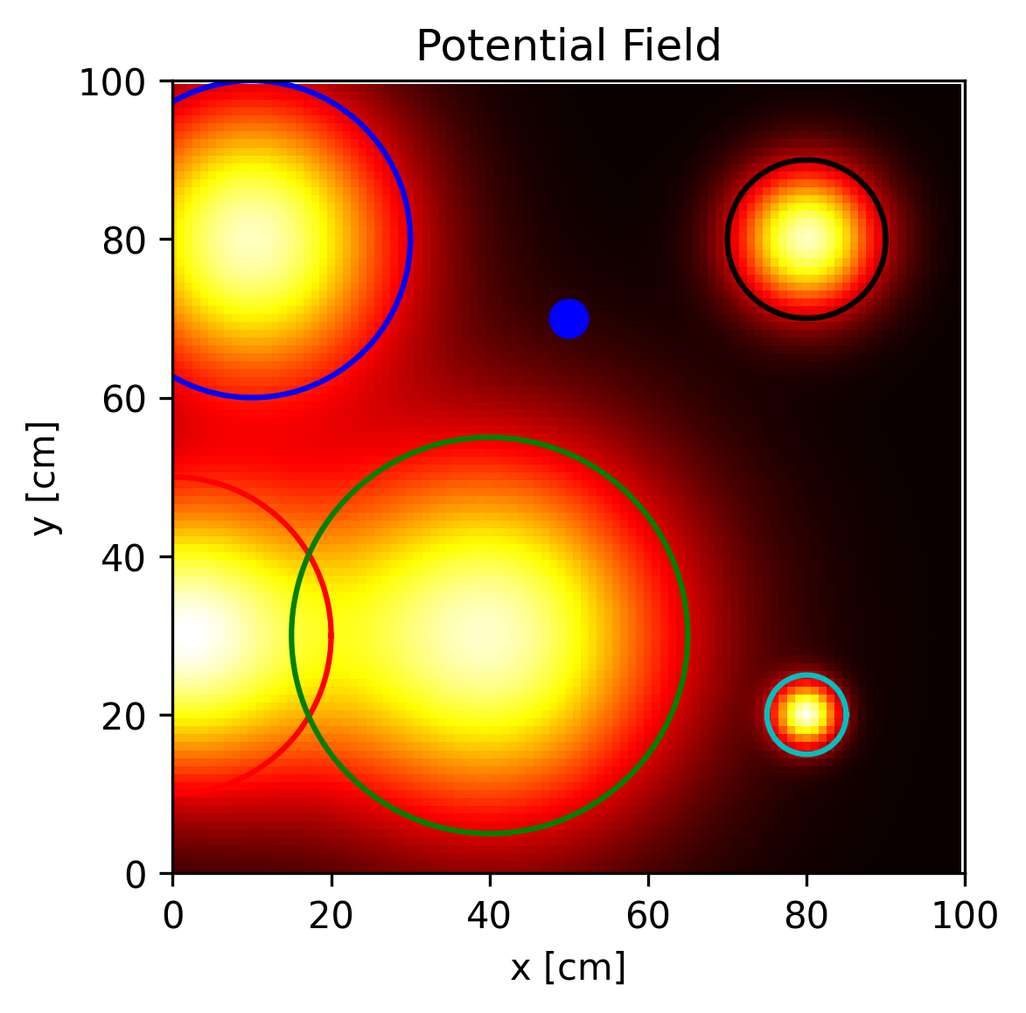
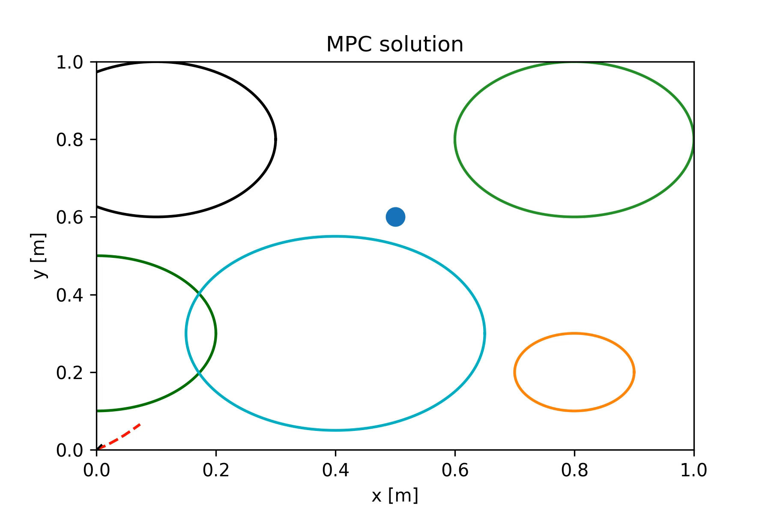
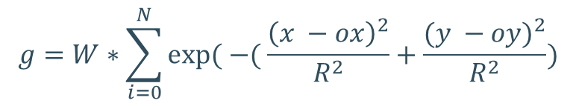
Potential field method
$$g=W∗\sum_{i=0}^{N}{exp⁡( −( \frac{{\left(x −ox\right)}^{2}}{R^{2}}+\frac{{(y −oy)}^{2}}{R^{2}})}$$
Obstacles have a repulsive force that is maximum at center
Solution follows gradient of the attractive + repulsive forces
The previous local minimum at obstacles corner disappears
New Problem: causing another local minimum close to the end point. Solution: turn off potential function at close proximity to goal

Slide 18
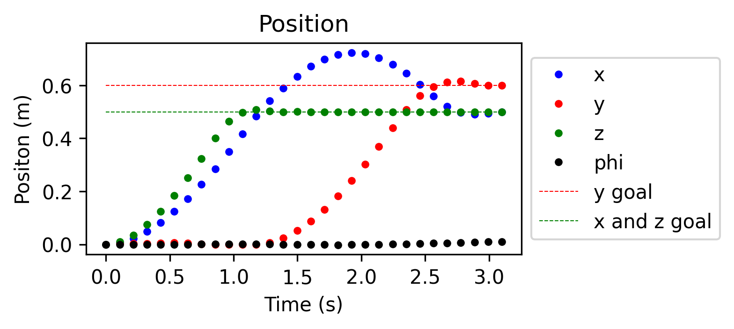
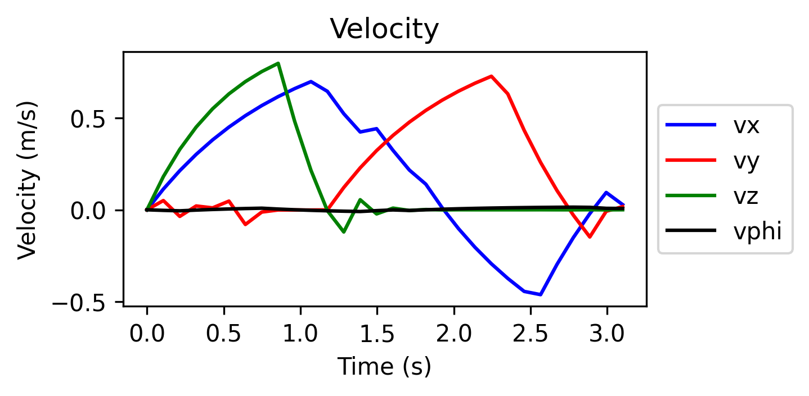
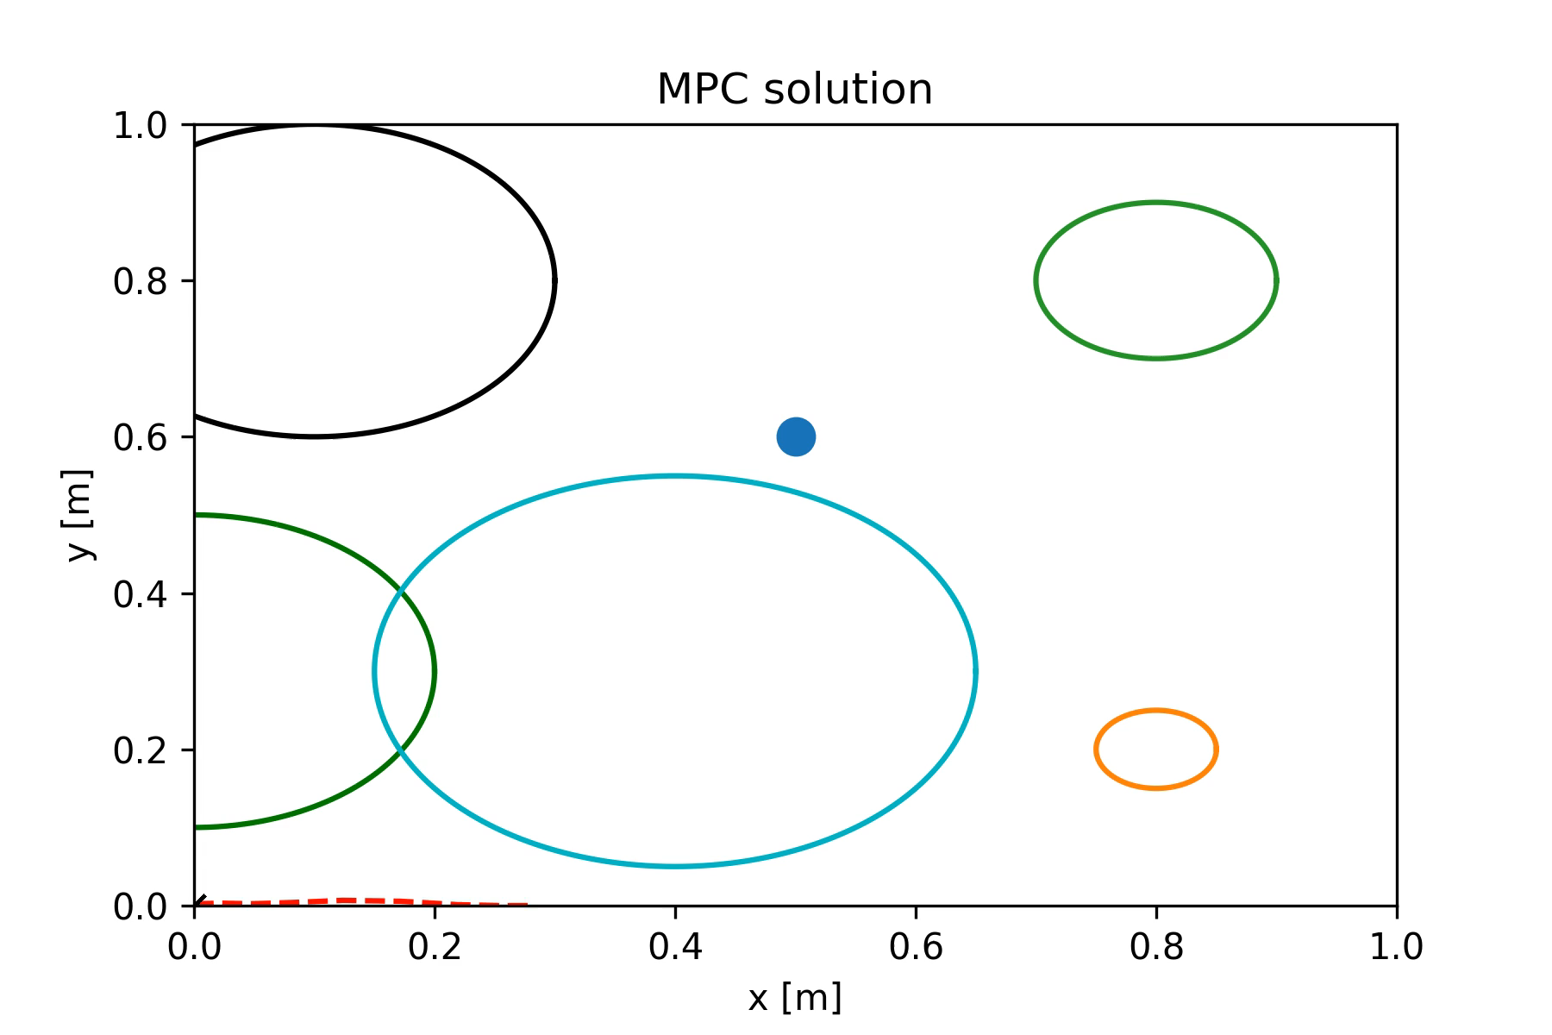
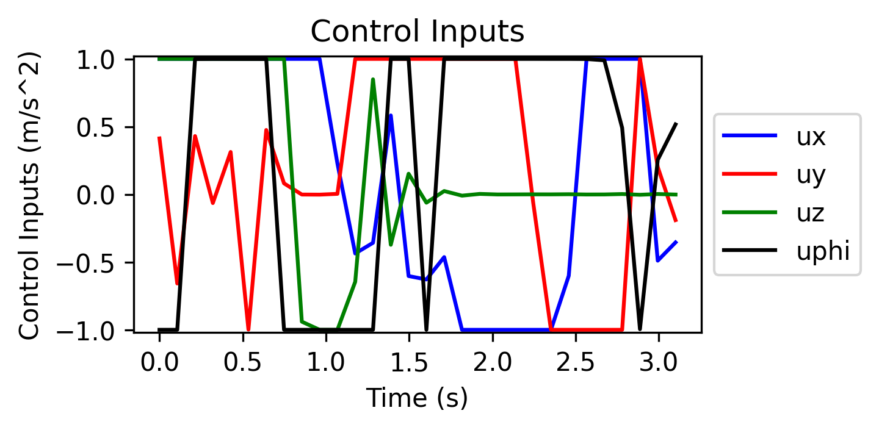
Potential field method: static obstacles
Control inputs show active constraints
Sensitive to weights = affects time optimality

Slide 19
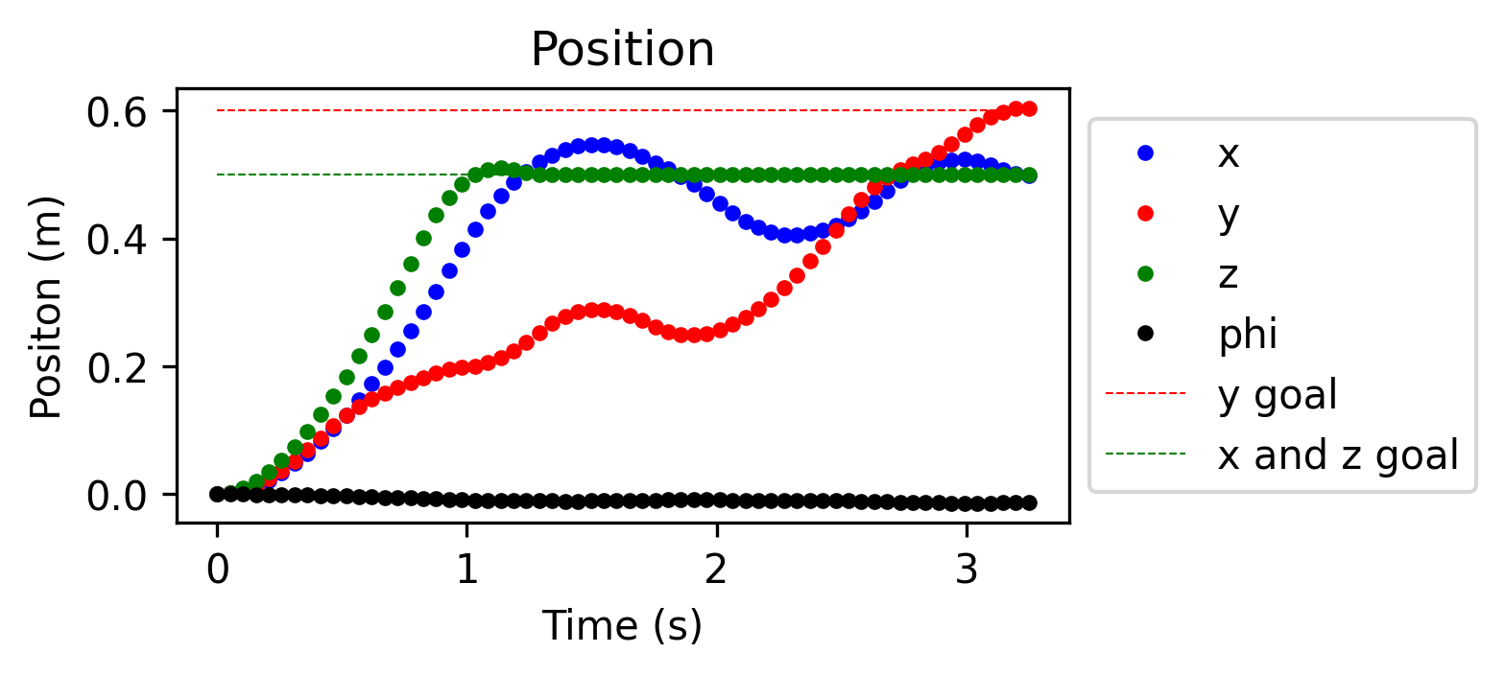
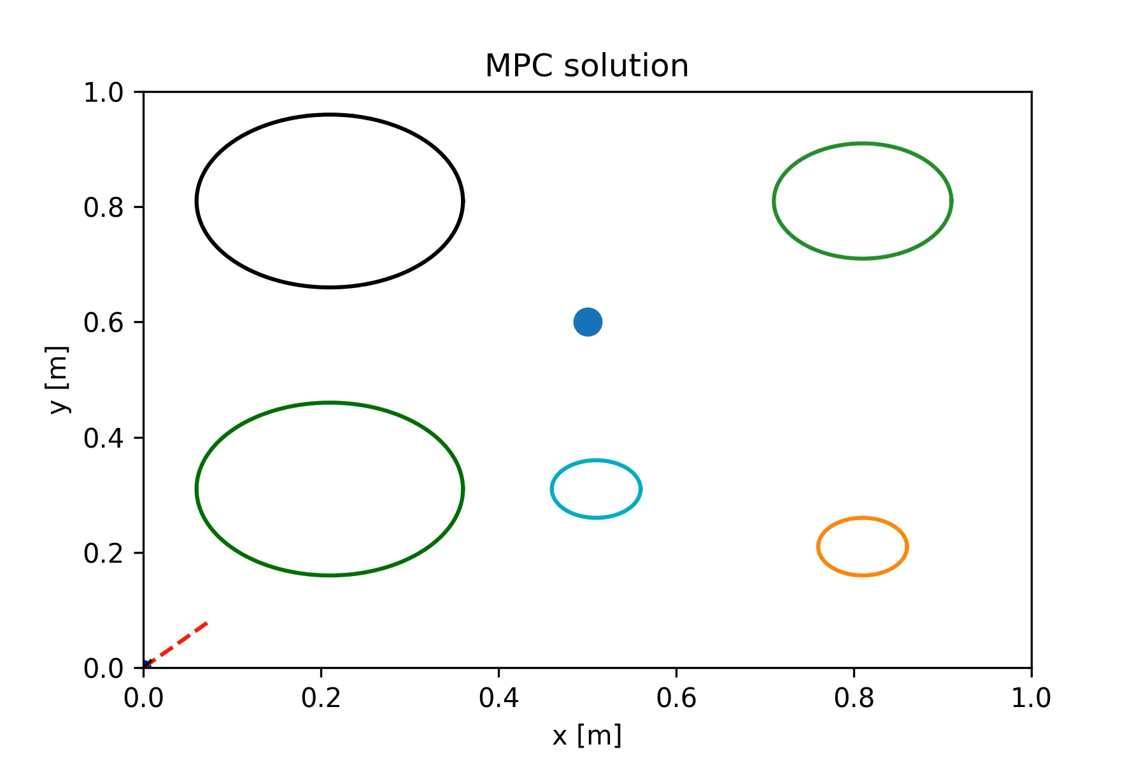
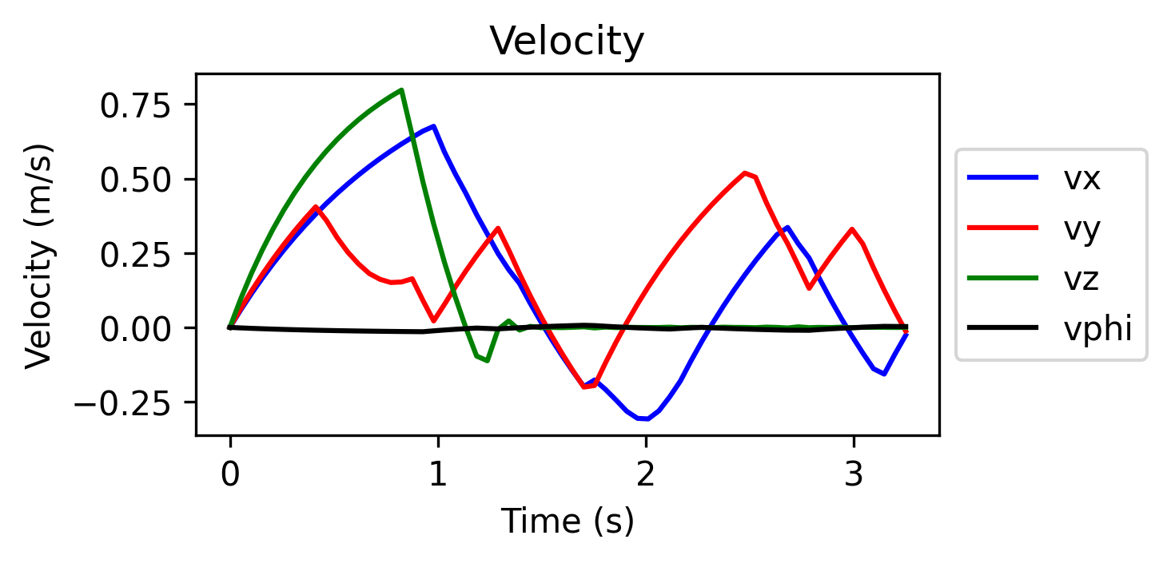
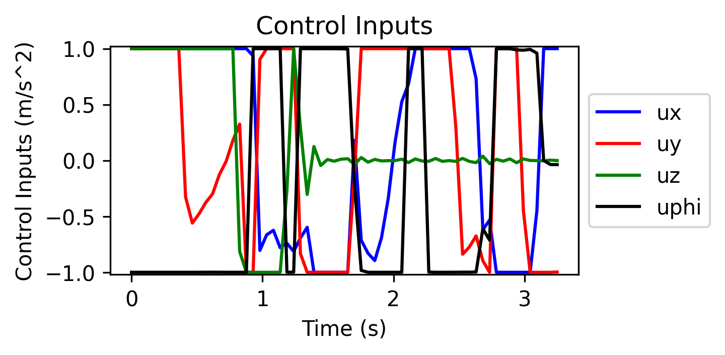
Potential field method: dynamic obstacles

Slide 20
Obstacle motion anticipation
Another approach for obstacle avoidance in dynamic environments is anticipating obstacle motion over the horizon length.
Assuming the number of obstacles and their positions can be detected by the drone at each MPC iteration, the velocity of each obstacle is approximated.
Obstacle displacement is updated throughout the horizon length as it is now a function of the time interval (N*dt)
However, this approach failed as the OCP did not react properly. Combined with a soft constraint on the obstacles, the drone tends to violate the constraints.

Slide 21
Conclusions
Modelling Obstacles
No major performance difference between L1 and L2 norm
Best Solution with Potential field in dynamic environments
Effects on Time Optimality

Slide 22
Thank you

Slide 23
References
M. Castillo-Lopez, S. A. Sajadi-Alamdari, J. L. Sanchez-Lopez, M. A. Olivares-Mendez and H. Voos, "Model Predictive Control for Aerial Collision Avoidance in Dynamic Environments," 2018 26th Mediterranean Conference on Control and Automation (MED), Zadar, 2018, pp. 1-6, doi: 10.1109/MED.2018.8442967.
Hermans, Ben, et al. “A Penalty Method Based Approach for Autonomous Navigation Using Nonlinear Model Predictive Control.” IFAC-PapersOnLine, vol. 51, no. 20, 2018, pp. 234–240.

